Slide 1
Critical Points, Local Maxima and Local Minima

Slide 2

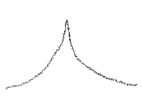



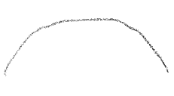
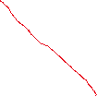

First Derivative Test
If f’(x) goes from positive to 0 to negative, then there is a local maximum at the point where f’(x) = 0
Similarly, if f’(x) goes from positive to undefined to negative, and if f(x) is defined at the point where f’(x) is undefined, then there is a local maximum at the point where f’(x) = 0

Slide 3
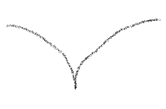



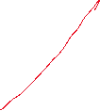
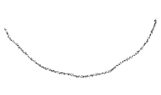


First Derivative Test (continued)
If f’(x) goes from negative to 0 to positive, then there is a local minimum at the point where f’(x) = 0
Similarly, if f’(x) goes from negative to undefined to positive, and if f(x) is defined at the point where f’(x) is undefined, then there is a local minimum at the point where f’(x) = 0

Slide 4


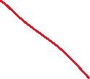
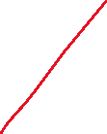
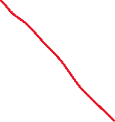



First Derivative Test (continued)
If f’(x) goes from positive to 0 to positive, then there is neither a maximum nor a minimum.
If f’(x) goes from negative to 0 to negative, then there is neither a maximum nor a minimum.

Slide 5
Critical Points and Critical Numbers
The points at which f(x) is defined and f’(x) = 0 or f’(x) is undefined are called critical points.
The values of x at which f’(x) = 0 or f’(x) is undefined are called critical numbers.

Slide 6
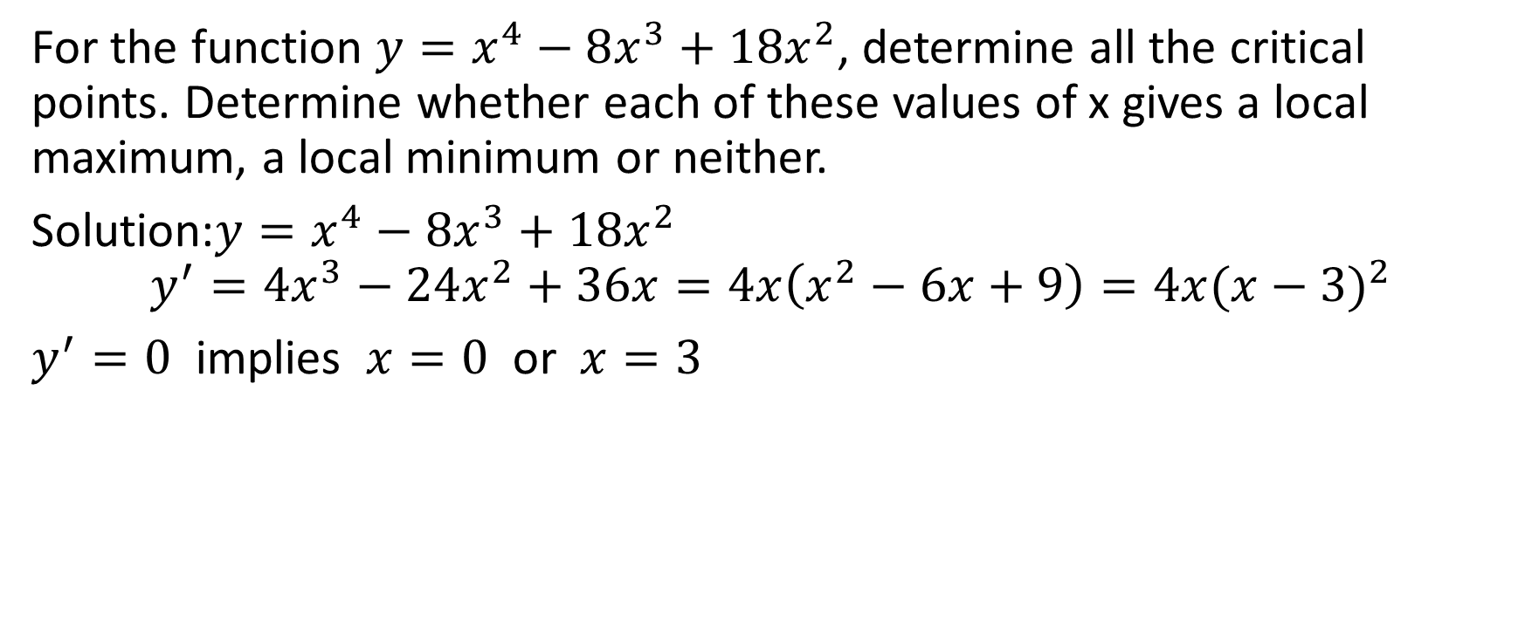



Example
For the function $y=x^{4}−8x^{3}+18x^{2}$, determine all the critical points. Determine whether each of these values of x gives a local maximum, a local minimum or neither.
Solution:$y=x^{4}−8x^{3}+18x^{2}$
$$y^{′}=4x^{3}−24x^{2}+36x=4x\left(x^{2}−6x+9\right)=4x{(x−3)}^{2}$$
$y^{′}=0$ implies $x=0$ or $x=3$

Slide 7
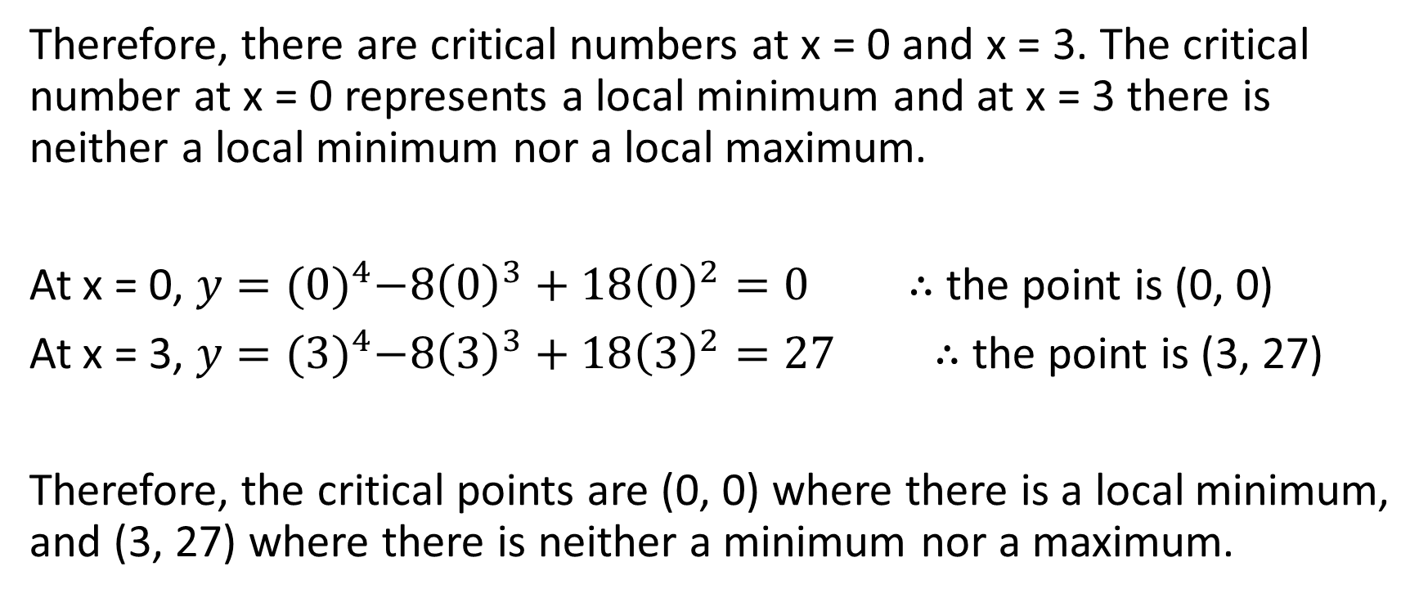
Therefore, there are critical numbers at x = 0 and x = 3. The critical number at x = 0 represents a local minimum and at x = 3 there is neither a local minimum nor a local maximum.
At x = 0, $y={(0)}^{4}−8{\left(0\right)}^{3}+18{\left(0\right)}^{2}=0$ $∴$ the point is (0, 0)
At x = 3, $y={(3)}^{4}−8{\left(3\right)}^{3}+18{\left(3\right)}^{2}=27$ $∴$ the point is (3, 27)
Therefore, the critical points are (0, 0) where there is a local minimum, and (3, 27) where there is neither a minimum nor a maximum.

Slide 8
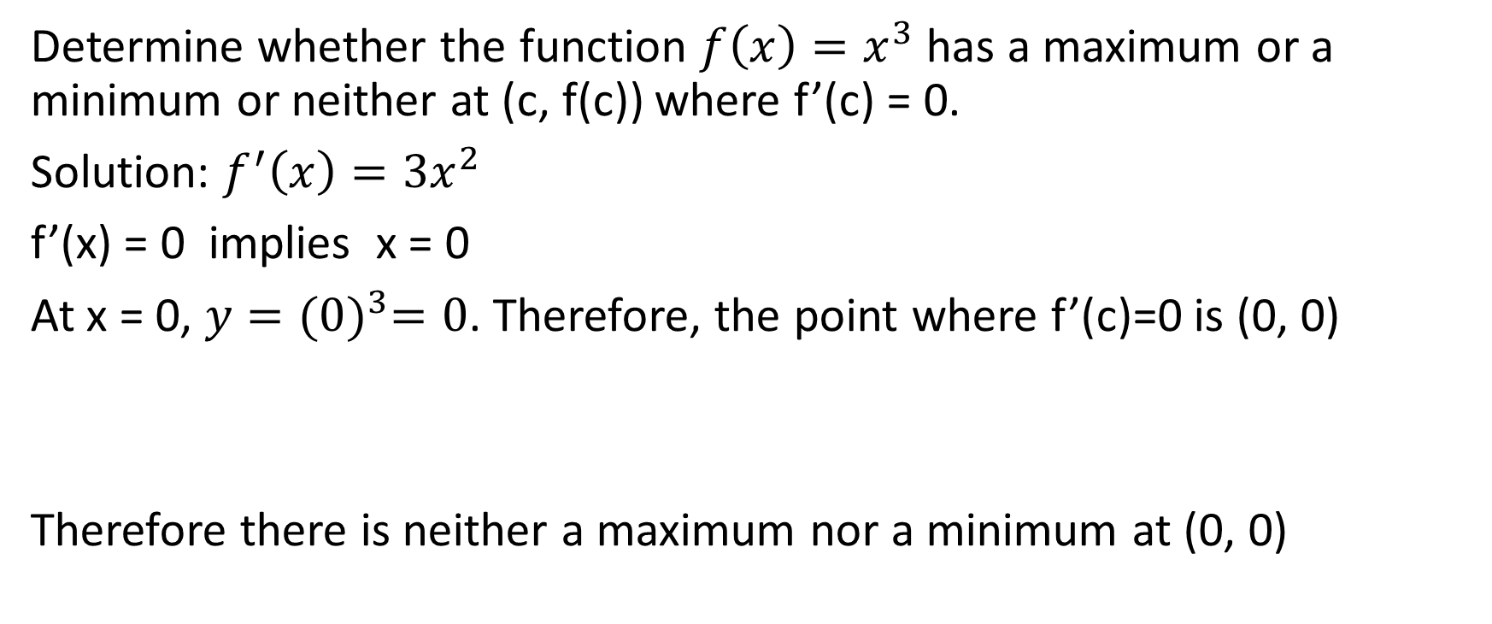
Example
Determine whether the function $f\left(x\right)=x^{3}$ has a maximum or a minimum or neither at (c, f(c)) where f’(c) = 0.
Solution: $f^{′}\left(x\right)=3x^{2}$
f’(x) = 0 implies x = 0
At x = 0, $y={(0)}^{3}=0$. Therefore, the point where f’(c)=0 is (0, 0)
Therefore there is neither a maximum nor a minimum at (0, 0)

Slide 9
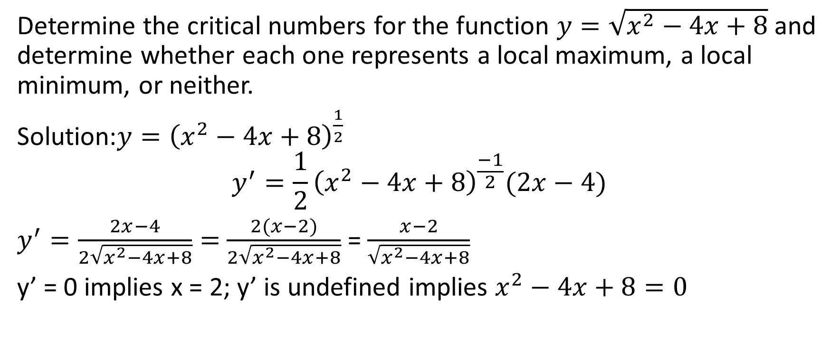
Example:
Determine the critical numbers for the function $y=\sqrt{x^{2}−4x+8}$ and determine whether each one represents a local maximum, a local minimum, or neither.
Solution:$y={\left(x^{2}−4x+8\right)}^{\frac{1}{2}}$
$$y^{′}=\frac{1}{2}{\left(x^{2}−4x+8\right)}^{\frac{−1}{2}}(2x−4)$$
$y^{′}=\frac{2x−4}{2\sqrt{x^{2}−4x+8}}=$ $\frac{2(x−2)}{2\sqrt{x^{2}−4x+8}}$ = $\frac{x−2}{\sqrt{x^{2}−4x+8}}$
y’ = 0 implies x = 2; y’ is undefined implies $x^{2}−4x+8=0$

Slide 10
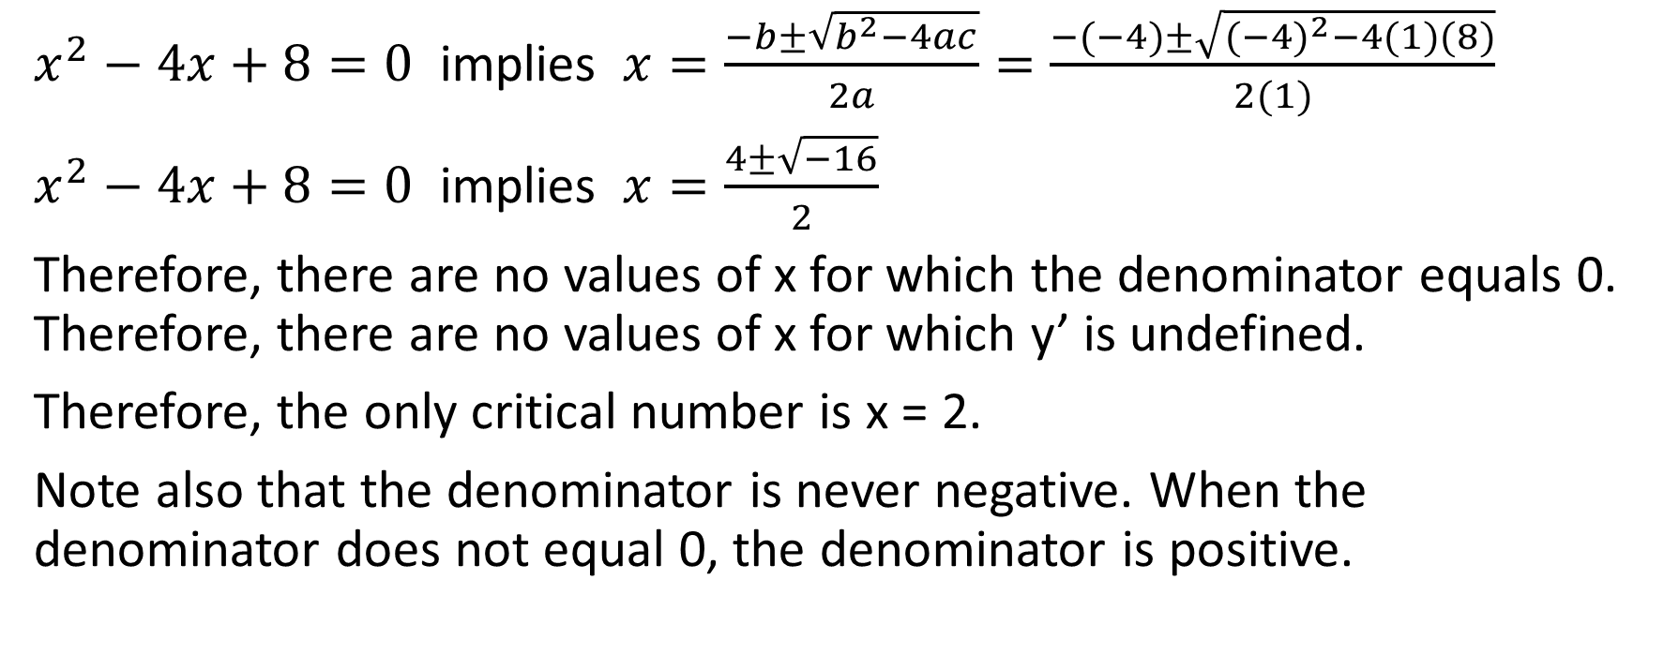
$x^{2}−4x+8=0$ implies $x=\frac{−b±\sqrt{b^{2}−4ac}}{2a}=\frac{−(−4)±\sqrt{{(−4)}^{2}−4(1)(8)}}{2(1)}$
$x^{2}−4x+8=0$ implies $x=\frac{4±\sqrt{−16}}{2}$
Therefore, there are no values of x for which the denominator equals 0. Therefore, there are no values of x for which y’ is undefined.
Therefore, the only critical number is x = 2.
Note also that the denominator is never negative. When the denominator does not equal 0, the denominator is positive.

Slide 11
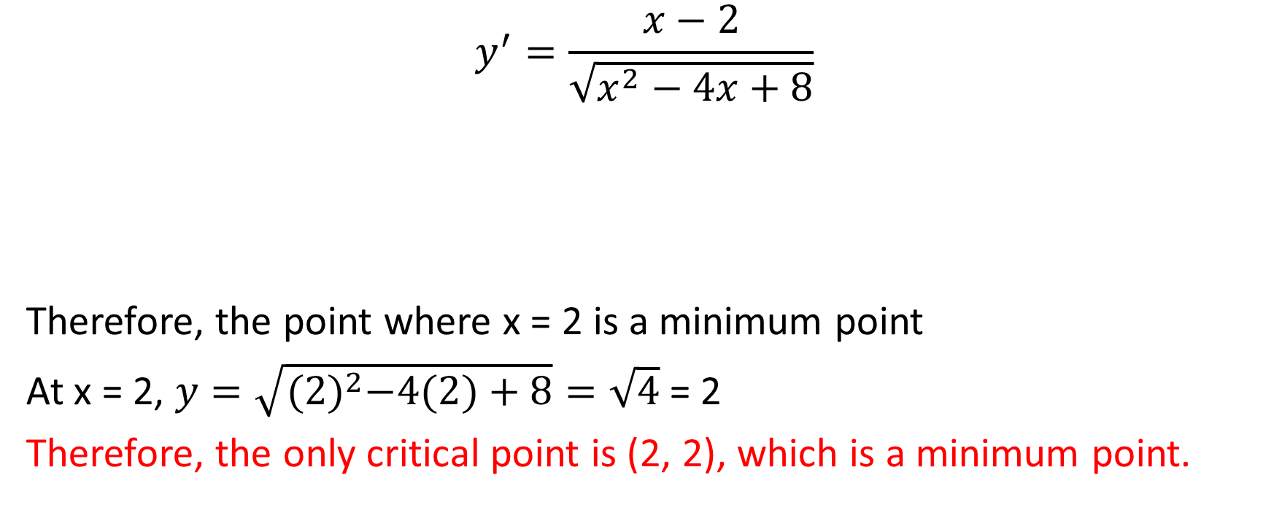
$$y^{′}=\frac{x−2}{\sqrt{x^{2}−4x+8}}$$
Therefore, the point where x = 2 is a minimum point
At x = 2, $y=\sqrt{{(2)}^{2}−4(2)+8}=\sqrt{4}$ = 2
Therefore, the only critical point is (2, 2), which is a minimum point.

Slide 12
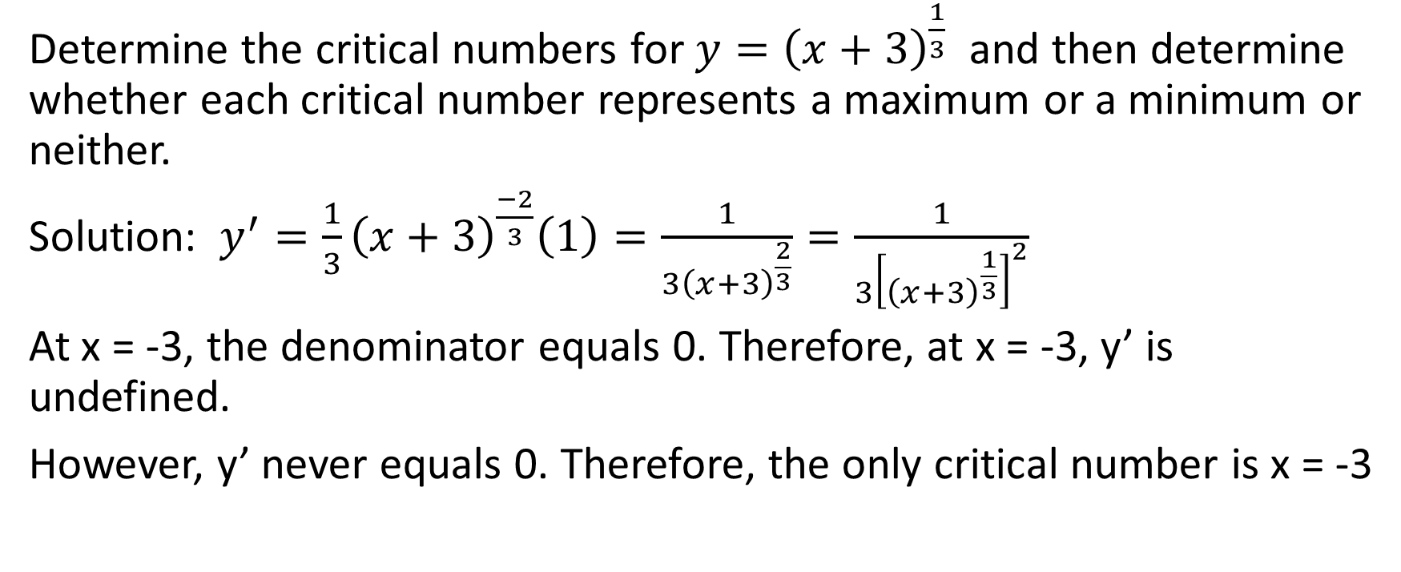
Example
Determine the critical numbers for $y={\left(x+3\right)}^{\frac{1}{3}}$ and then determine whether each critical number represents a maximum or a minimum or neither.
Solution: $y^{′}=\frac{1}{3}{\left(x+3\right)}^{\frac{−2}{3}}\left(1\right)=\frac{1}{3{\left(x+3\right)}^{\frac{2}{3}}}=\frac{1}{3{\left[{\left(x+3\right)}^{\frac{1}{3}}\right]}^{2}}$
At x = -3, the denominator equals 0. Therefore, at x = -3, y’ is undefined.
However, y’ never equals 0. Therefore, the only critical number is x = -3

Slide 13
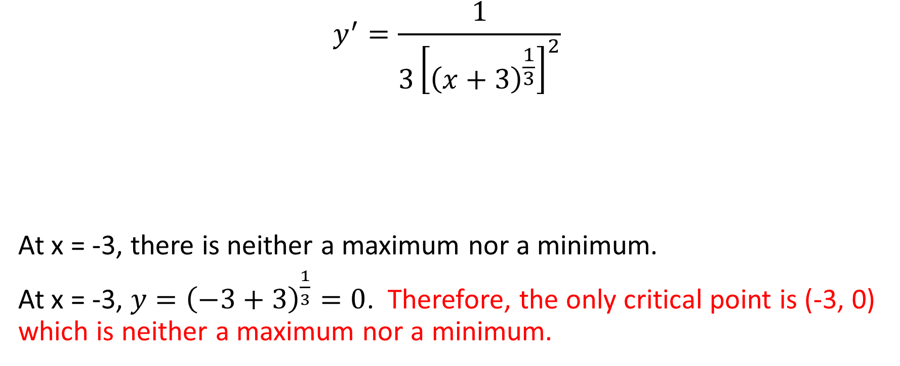
$$y^{′}=\frac{1}{{3\left[{\left(x+3\right)}^{\frac{1}{3}}\right]}^{2}}$$
At x = -3, there is neither a maximum nor a minimum.
At x = -3, $y={\left(−3+3\right)}^{\frac{1}{3}}=0$. Therefore, the only critical point is (-3, 0) which is neither a maximum nor a minimum.

Slide 14
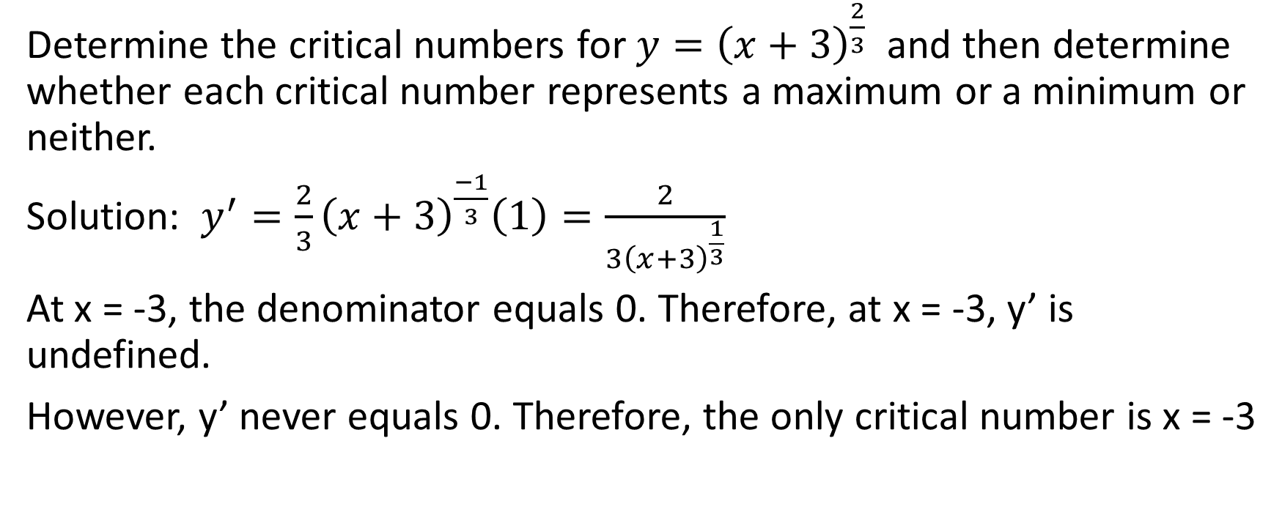
Example
Determine the critical numbers for $y={\left(x+3\right)}^{\frac{2}{3}}$ and then determine whether each critical number represents a maximum or a minimum or neither.
Solution: $y^{′}=\frac{2}{3}{\left(x+3\right)}^{\frac{−1}{3}}\left(1\right)=\frac{2}{3{\left(x+3\right)}^{\frac{1}{3}}}$
At x = -3, the denominator equals 0. Therefore, at x = -3, y’ is undefined.
However, y’ never equals 0. Therefore, the only critical number is x = -3

Slide 15
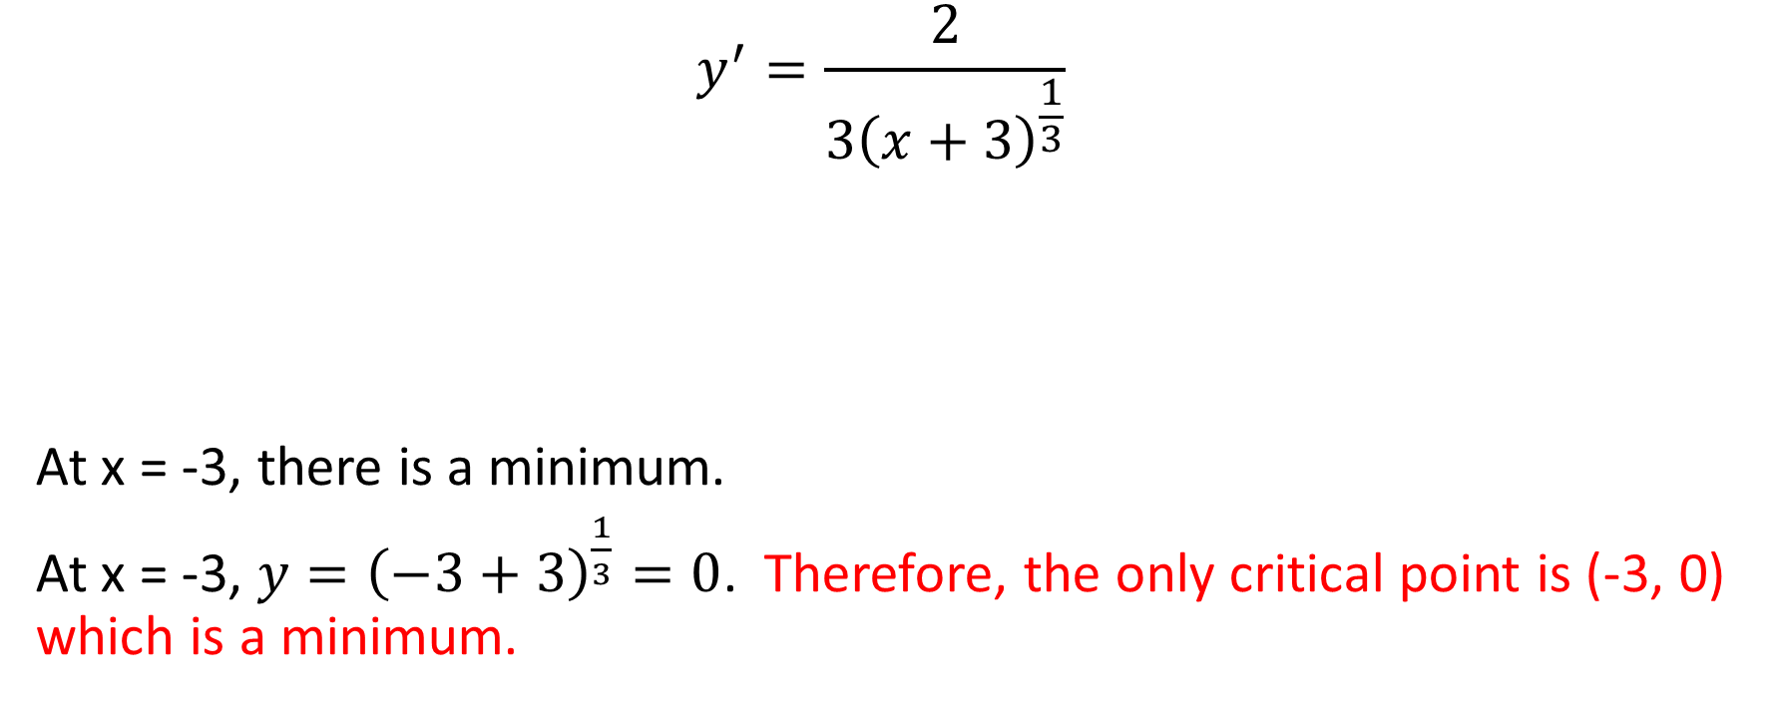
$$y^{′}=\frac{2}{3{\left(x+3\right)}^{\frac{1}{3}}}$$
At x = -3, there is a minimum.
At x = -3, $y={\left(−3+3\right)}^{\frac{1}{3}}=0$. Therefore, the only critical point is (-3, 0) which is a minimum.

Slide 16
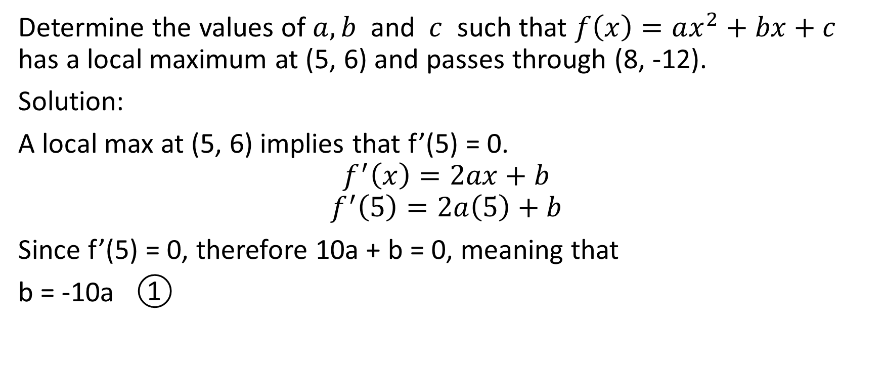
Example
Determine the values of $a, b$ and $c$ such that $f\left(x\right)=ax^{2}+bx+c$ has a local maximum at (5, 6) and passes through (8, -12).
Solution:
A local max at (5, 6) implies that f’(5) = 0.
$$f^{′}\left(x\right)=2ax+b$$
$$f^{′}\left(5\right)=2a\left(5\right)+b$$
Since f’(5) = 0, therefore 10a + b = 0, meaning that
b = -10a ①

Slide 17
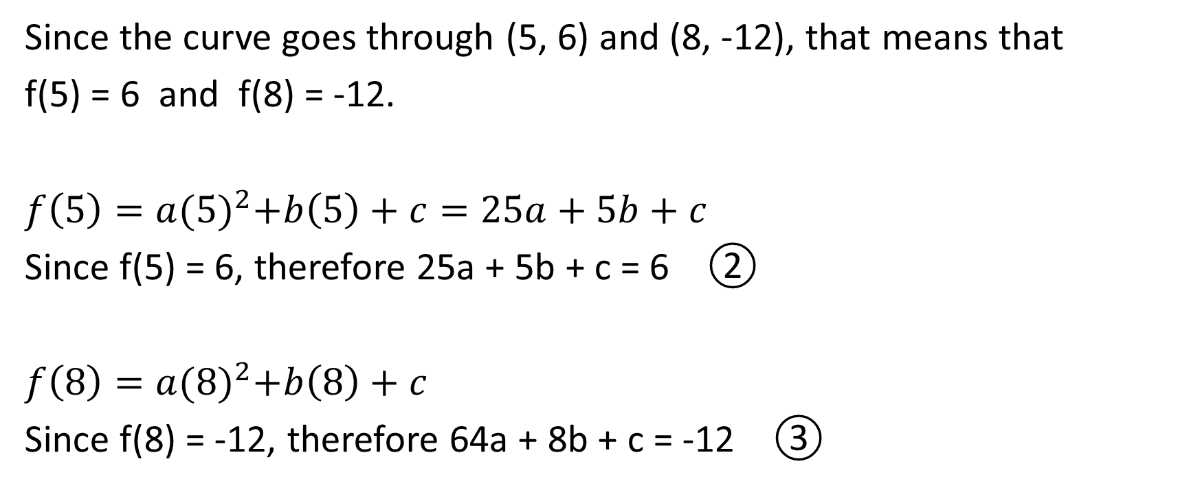
Since the curve goes through (5, 6) and (8, -12), that means that
f(5) = 6 and f(8) = -12.
$f\left(5\right)=a{(5)}^{2}+b\left(5\right)+c=25a+5b+c$
Since f(5) = 6, therefore 25a + 5b + c = 6 ②
$f\left(8\right)=a{(8)}^{2}+b\left(8\right)+c$
Since f(8) = -12, therefore 64a + 8b + c = -12 ③

Slide 18
Let’s plug in equation ① to equation ② and ③.
Equation ② becomes 25a + 5(-10a) + c = 6
25a – 50a + c = 6
c = 25a + 6 ④
Equation ③ becomes 64a + 8(-10a) + c = -12
64a – 80a + c = -12
c = 16a – 12 ⑤
Now, putting together equations ④ and ⑤ on the next slide →

Slide 19
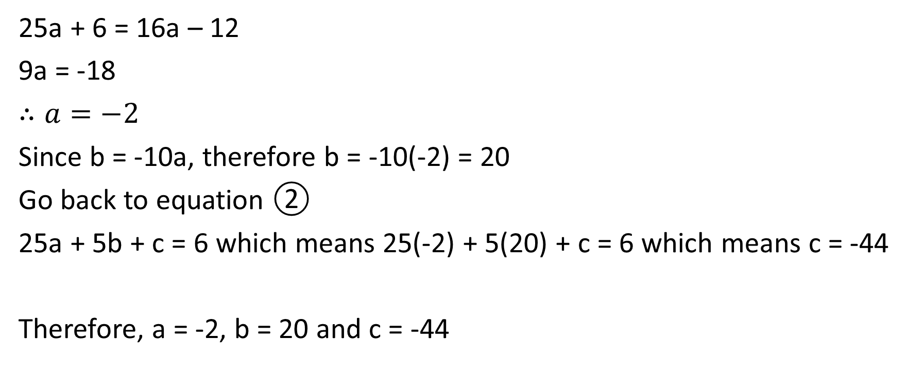
25a + 6 = 16a – 12
9a = -18
$∴a=−2$
Since b = -10a, therefore b = -10(-2) = 20
Go back to equation ②
25a + 5b + c = 6 which means 25(-2) + 5(20) + c = 6 which means c = -44
Therefore, a = -2, b = 20 and c = -44

Slide 20
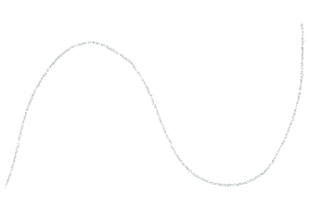


Example
Given the curve of y = f(x) shown below, graph the curve y = f’(x)

Slide 21
Example
At any point where y = f(x) has a
minimum or a maximum, that is where
f’(x) = 0, meaning that the graph of
y = f’(x) will have an x-intercept.

Slide 22

Example
Over any intervals where y = f(x) is
decreasing, f’(x) is negative. This means
that the curve of y = f’(x) is below the x-axis.

Slide 23





Example
Over any intervals where y = f(x) is
decreasing, f’(x) is negative. This means
that the curve of y = f’(x) is below the x-axis.

Slide 24
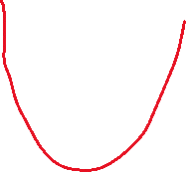
Example
Note that y = f(x) is cubic, and y = f’(x) is
quadratic ☺

